Slide 1
Student Focus: an Email Thread Analysis

Slide 2

Hello! I am Amy Canavan
I teach the following subjects at the following schools:
Century College: Statistics
Metropolitan State University: Statistics
University of Wisconsin, River Falls: College Algebra & Trigonometry
In my presentation for DATA 211, I will examine a selection of student email interactions.

Slide 3
Presentation Organization
Problem Context
Data
Methods & analysis
Results
Concluding Remarks

Slide 4

Problem Context

Slide 5
I have stated (complained) many times …
It doesn’t seem like students care about learning!
At best, only half of my time is spent actually helping students with mathematics.
The rest of my time is spent dealing with course issues and questions about late work, extra credit, and grades.

Slide 6
A Unique Opportunity:
COVID 19 Pandemic
Asynchronous online classes
Most of my student-teacher interaction is via email
I can analyze email threads as a proxy for the more difficult task of analyzing “time spent” or all student interactions.

Slide 7
Data

Slide 8
Overview
One month of data
February 2022 avoids the beginning of the semester & spring break
“Sent mail” from my Outlook account
All emails from all jobs are forwarded to this account
Each thread counts as one interaction
I answer all my messages!

Slide 9
Data Collection
“Sent items” folder in Outlook
Searched for all threads that included a message sent from me during February 2022
These messages were then categorized.

Slide 10
Categories
With a student and the topic was logistical (grades, extra credit, course policies, etc.)
With a student and the topic was mathematics
With a colleague (department policies, meetings, tasks)
Personal (lunch with a friend, dry cleaning pickup, etc.)
With an instructor (I am a student too!)

Slide 11
Ethics & Privacy
The person with whom I am corresponding is not identified
If the person is a student, I do not identify what school they go to, class they are in, or topic of discussion
Colleagues are not identifiable
My instructors are not identified (sort of!)
Any personal correspondences are not identifiable

Slide 12

Variables
SLogistics
SMath
Colleague
Personal
Instructor
Each email thread is a data point with two variables.
Date: the date that the thread began
Type: type of interaction

Slide 13
Methods & Analysis

Slide 14
Hypothesis Test
I wish to test my claim that less than half my time is spent actually helping students with mathematics
I cannot test exactly this, but I can get an idea of how my time is divided by running a different test
I will test the claim that less than 50% of email threads with students are regarding mathematics

Slide 15
Hypothesis Test
I will test the claim that less than 50% of email threads with students are regarding mathematics

Slide 16
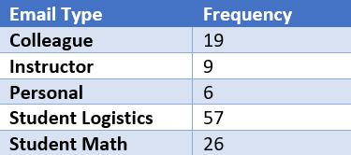
Preparing the Data
Frequency table for the types of email threads from the dataset.

Slide 17
One Proportion Z Test
Then I used R to run a one proportion Z test.
prop.test(x = 26, n = 57 + 26, p = 0.5, alternative = "less")
data: 26 out of 57 + 26, null probability 0.5
X-squared = 10.843, df = 1, p-value = 0.0004957
alternative hypothesis: true p is less than 0.5
95 percent confidence interval:
0.0000000 0.4080092
sample estimates:
p
0.313253

Slide 18
Results

Slide 19
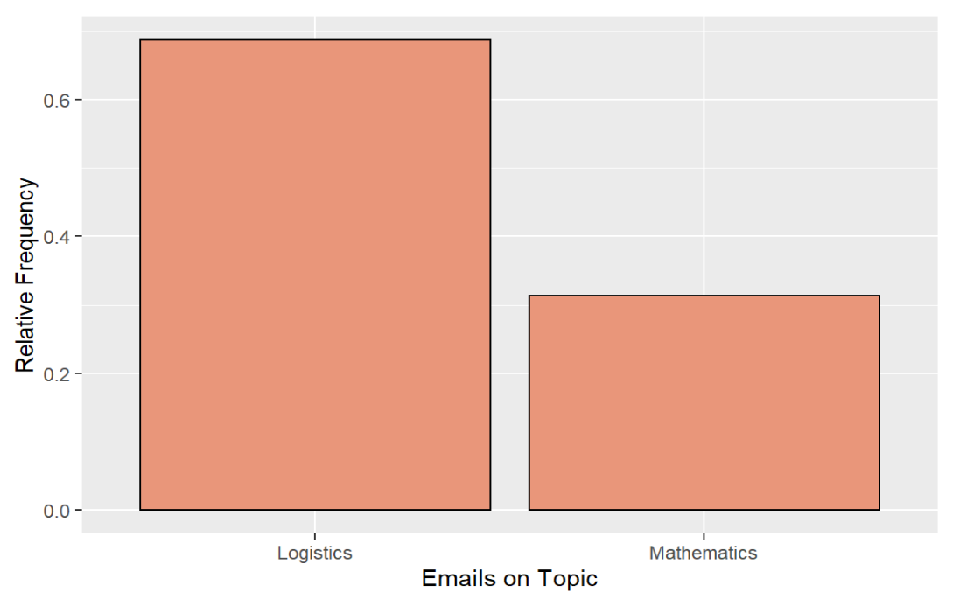
Visual: Bar Chart

Slide 20
Hypothesis Test Results
At the 99% confidence level (α = 0.01), we reject the null hypothesis.
Based on the February 2022 email thread data, there is evidence to support the claim that less than 50% of email threads with students are regarding mathematics

Slide 21
Concluding Remarks

Slide 22
Summary of Results
In the study student-teacher email interactions, only 31% were about mathematics. The remaining 69% were about course logistics, mainly related to grades and asking for exceptions to syllabus.
And again, based on the data, there is evidence to support the claim the true proportion of student-instructor email threads that are about mathematics rather than logistics is less than half (50%).

Slide 23
An Important Question!
So, should we conclude that students don’t care about learning and only care about grades?
I don’t think so, and experts agree. It is quite possible that grading itself is part of the issue.

Slide 24
[T]he continual assessment of students through tests, grades, and homework is part of why so many students have a negative relationship with mathematics. (Boaler, 2015)
[P]oints-based grading … encourages students to avoid challenging work, and teaches students to value grades over knowledge.” (Lahey, 2018)

Slide 25
A culture of grading leads students to care about grades!

Slide 26
Possible Solutions?
Better explanations about logistics
Less “required” content in the syllabus
Alternative methods of assessment
Clear rationale for courses and work within courses
Rethink some requirements/flexibility

Slide 27
Thank you for listening and for your feedback!

Slide 28

References
Boaler, J. (2015). Learning and Leading Together [Presentation] California Mathematics Council South, 56th Annual Mathematics Conference, Oceanside, CA, United States.
Lahey, Jessica. “Letter Grades Deserve an ‘F’.” The Atlantic, Atlantic Media Company, 19 June 2018, www.theatlantic.com/education/archive/2014/03/letter-grades-deserve-an-f/284372/.
Free templates for all your presentation needs

